Slide 1
Dataset
  Chest X-ray images :
    Training set- {covid: 460,normal: 1266 , pneumonia: 3418 }
    Test set – {covid: 116,normal: 317, pneumonia: 855}

Slide 2
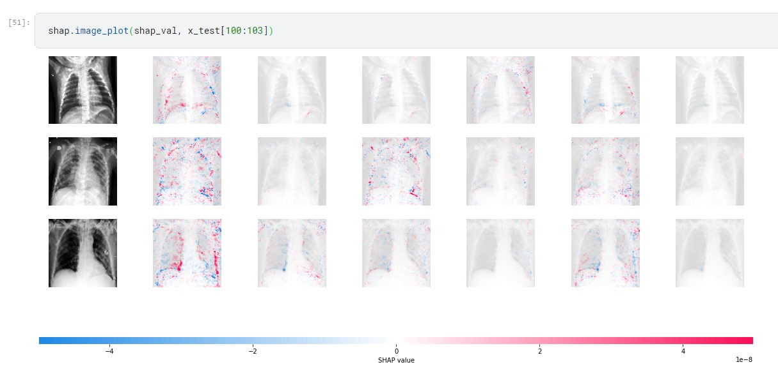
Shap values –try out on RestNet50 model prediction
Need to fine tune results**

Slide 3
Shapley
Tang, S., Ghorbani, A., Yamashita, R. et al. Data valuation for medical imaging using Shapley value and application to a large-scale chest X-ray dataset. Sci Rep 11, 8366 (2021). https://doi.org/10.1038/s41598-021-87762-2
Few shot learning
Chen, X., Yao, L., Zhou, T., Dong, J. and Zhang, Y., 2021. Momentum contrastive learning for few-shot COVID-19 diagnosis from chest CT images. Pattern recognition, 113, p.107826.
Luz, E., Silva, P., Silva, R., Silva, L., Guimarães, J., Miozzo, G., Moreira, G. and Menotti, D., 2022. Towards an effective and efficient deep learning model for COVID-19 patterns detection in X-ray images. Research on Biomedical Engineering, 38(1), pp.149-162.

Slide 4
Progress
CNN, ResNet50 without resampling – done
CNN, ResNet50 with resampling(oversampling and under sampling) – done
Shapley values on models – in progress
Few shot learning – in progress
  A comparative study of the results of all the models?
“Make sure you understand how a medic would identify covid from the image.”
  Based on ground-glass opacities(hazy grey areas) and consolidation.
  Ng, M.Y., Lee, E.Y., Yang, J., Yang, F., Li, X., Wang, H., Lui, M.M.S., Lo, C.S.Y., Leung, B., Khong, P.L. and Hui, C.K.M., 2020. Imaging profile of the COVID-19 infection: radiologic findings and literature review. Radiology: Cardiothoracic Imaging, 2(1).
  Find references from papers, or should we seek help from a medic to understand covid identification?

